Slide 1
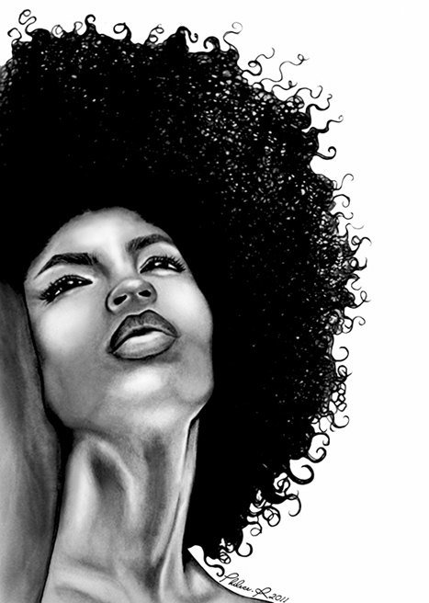

Happy and Nappy ... or Not?
African American Women Wearing
Natural Hair Experience Stigma
Jocelyn D Jones
April 17, 2014
SO 499 A
Bethune-cookman University
Sociology Department

Slide 2
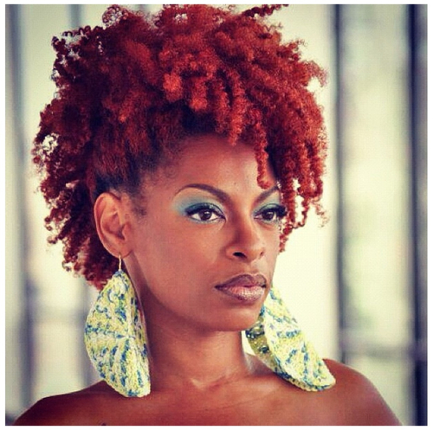
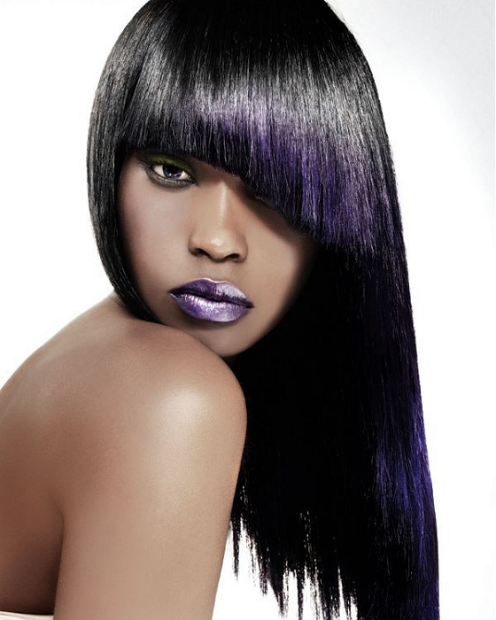
NATURAL HAIR VS. STRAIGHT HAIR

Slide 3
INTRODUCTION
The purpose of this study was to determine whether Black women who wore their hair in the natural form experienced more negative societal reactions than Black women who wore their hair in other forms.
By placing Black women at the center of analysis, using the combination of Black Feminist Epistemology (BFE) and Strain/breakdown Theory, this qualitative study contributed a unique viewpoint to the field of sociology.

Slide 4
Introduction
Three reasons why a study about the social reactions to
Black women’s natural hair was important
Reason #1
To explore the decisions made by Black women to wear their hair in the natural form or any other form was part of the process of identity construction and identity assertion.
For Black women, the power of asymmetry within American society between Blacks and other racial categories Black women’s experiences and their own realities are often belittled or stigmatized

Slide 5
Introduction
Three reasons why a study about the social reactions to
Black women’s natural hair was important
Reason # 2
“Black Feminist Thought “specializes in formulating
and rearticulating the distinctive, self-defined standpoint
of Black women” (Collins 1989:750).
Qualitatively examine a variety of Black women’s experiences with their hair using concepts of intersectionality and pinpoint how this affected the quality of Black women’s lives
To explore historical conditions of negative reactions towards black women who choose to wear natural hair. which stealthily reduced Black women’s rights and opportunities under the power of rich, white men and their ilk.

Slide 6
Introduction
Three reasons why a study about the social reactions to
Black women’s natural hair was important
Reason # 3
The study raised very important question that helped to frame Black women’s experiences with their hair.
What did it mean for Black women to have curly, wavy hair as opposed to straight hair or some other type of hair?
Whose idea of what was culturally appropriate defined the various hairstyles available to Black women and what conception was idealized when Black women wore natural hair?
Did Black women who wore their natural hair face differential reactions from society and how was the reaction reflective of (phenotypical) differences between Whites and Blacks, or between rich and poor, or the superior normativity of patriarchy?

Slide 7
Purpose of Study
To discover why black women choose to wear natural hair and other forms of hairstyles, thus, understand why black women were stigmatized for choosing to wear chemically free tresses.
To give historical and contemporary information in order to gain meaning and insight about natural hair, straight hair, and other hairstyles.
To gain a retrospective view about the genesis of stigmas developed historically during slavery and an overview on how stigmas of the past influence the perceptions of African American women’s body image in contemporary times.
My goal
In essence, my goal was not only to anticipate possible multiple influences on their decision, but also fully explore the full range of the experiences of Black women who wore their hair in the natural form from the standpoint of the women themselves.

Slide 8
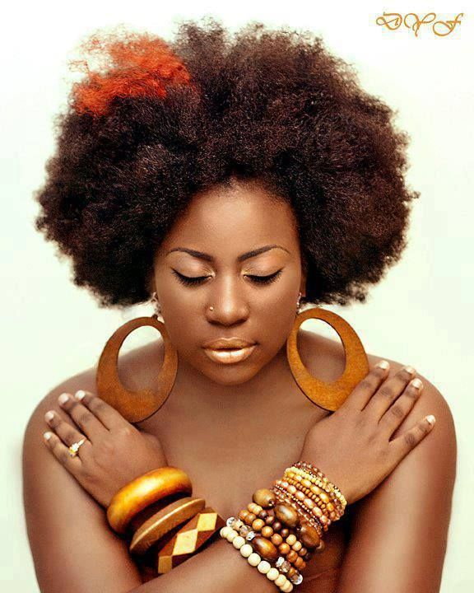
Literature Review
Black hair Care market
Natural hair
Straight Hair
Negative Stigma in Ads and the Media
Stigmas about Hair Texture
Politics of Black Hair

Slide 9
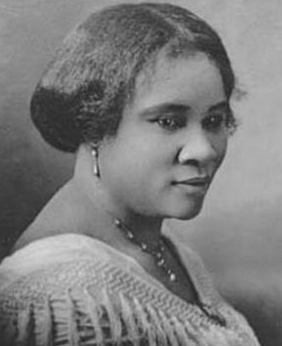
Lit Review
Black Hair Care Market
The black hair care market in the U.S. was pioneered by African-American entrepreneurs.
According to Davis 2001:35, “Several Black females catered to this niche by the early 1900s. Among them were Anna Malone (aka Annie Pope-Tumbo) who developed the Poro System in St. Louis, Madam Estella who founded the Nu-Life School of Beauty Culture in New York City and Madam C.J. Walker”.
Since Madam C.J. Walker created and marketed the first hair products exclusively made for black hair, the relaxed or straight look for Black women’s hair has gained force. Her most famous invention was "Wonderful Hair Grower“.

Slide 10

Lit Review
Black Hair Care Market (con’t)
The Black hair care market was a small market even during the Civil Rights era and small Black owned businesses monopolized the market.
in the mid-1980s, Large mainstream corporations such as Alberto-Culver, Clairol, and Revlon competed with black hair care market to gain a sufficient foothold of the black hair care market.
These white owned companies used enchanting names on black hair care products such as “African Pride”, “Dark and Lovely”, and “Right On Curl” to allure black customers and many of the blacks were angry about the deceitful marketing tatics of white companies (Davis 2001).
Presently, the blacks are losing control over the black hair care market. Thompson (2009:85) stated, “In America, black hair care (non-natural) is an estimated $1.8 billion to $15 billion industry. Market research firm Mintel reports that although blacks make up 13 percent of the population, they account for 30 percent of hair care spending and 90% of the black hair care market is controlled by the Koreans.

Slide 11
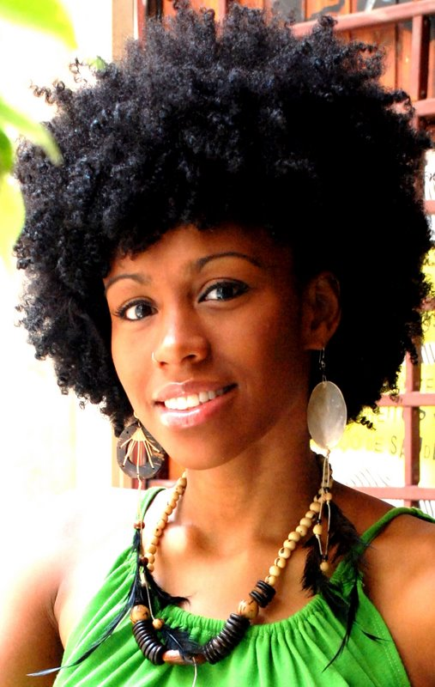
Natural Hair

Slide 12
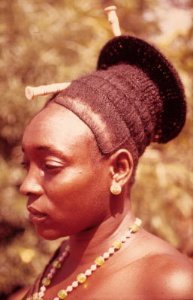
Natural Hair
What is natural hair?
Frances (2011) defines Black women’s natural hair as “hair that is not processed and not chemically altered”.
Historically, Africans have worn their hair in the natural form for various reasons. “In early fifteenth century hair functioned as a carrier of messages or was an integral part of a complex language system in most west African societies” (Byrd and Tharps 2002:2).
African, hairstyles have been used to indicate a person’s
marital status
lineage
community or for naming
natural hairstyles as a connection to the spirit world
natural hairstyles in artistic African artistry

